Slide 1
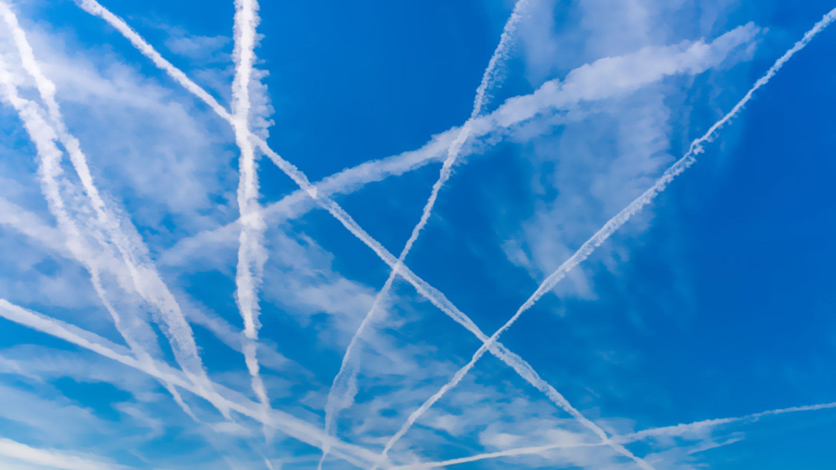
A ClimateViewer News Production
CARBON BLACK DUST & SOOT
The Chemtrail Secret for Weather Warfare, Geoengineering, and Ozone Destruction
CLIMATEVIEWER.COM/CIRRUSCLOUDSMATTER/

Slide 2
CARBON BLACK DUST & SOOT
CRUCIAL FOR ARTIFICIAL CIRRUS CLOUD CREATION
WEATHER WARFARE: U.S. Air Force and Navy FOIA documents and Presentations
GEOENGINEERING: CBD & Soot is a carrier for metals and sulfur into the stratosphere
OZONE: CBD & Soot levitates into stratosphere,
METALS AND SULFUR DESTROY OZONE
Is released in exhaust of jet aircraft by burning fuels (soot) or dumped/pumped from military aircraft (carbon black).

Slide 3
CARBON BLACK DUST vs. SOOT
Carbon black is composed of turbostratic colloidal aggregates which we call aciniform carbon (AC, grape-like clusters ). Chimney soots from domestic wood or coal fires contain very little AC, while in diesel soots the solid particulates are essentially all AC. [2]
01
Carbon black and soot often have been used interchangeably; however, carbon black is physically and chemically distinct from soot. [1]
02
04
Carbon black is manufactured under controlled conditions for commercial use. Greater than 97% of carbon black consists of elemental carbon arranged as acinoform particulate. [3]
Soot is the unwanted by-product of combustion of carbon-based materials for the generation of energy or heat, or for waste disposal. Less than 60% of the total soot particulate mass is carbon. Soot has much greater percentages of ash and solvent extractable organic compounds. [3]
03

Slide 4
CARBON BLACK DUST vs. SOOT
Military Application vs. Commercial Pollution
CARBON BLACK
SOOT
Military Use - Weather Warfare:
Increase Cirrus Cloud Cover
Increase/decrease precipitation
Dissipate Fog
Commercial Aviation – Weather Modification & Geoengineering
Increase Cirrus Cloud Cover
Alter Rainfall Patterns
Affects Solar Radiation: cools by day, traps heat by night
Contains metals, coated in sulfur dioxide and sulfuric acid
Scientific – Weather Modification:
Hurricane Modification
Increase/decrease precipitation
Increase Cirrus Cloud Cover
Dissipate Fog

Slide 5
SOOT – CLOUD SEEDING
FILLED WITH METALS, COVERED IN SULFUR
The detected metallic compounds were all internally mixed with the soot particles. The most abundant metals in the exhaust were Chromium, Iron, Molybdenum, Sodium, Calcium, and Aluminum; (also detected were) Vanadium, Barium, Cobalt, Copper, Nickel, Lead, Magnesium, Manganese, Silicon, Titanium, and Zirconium. " “Considering that some fraction of soot can effectively act as INP and that a dominant fraction of ice residuals in cirrus clouds contain metal compounds the presented findings support the assumption that aircraft engine emissions can act as INP (Ice Nucleating Particle, or Cloud Condensation Nuclei CCN, or Cloud Seed)”
Abegglen, Manuel, et al. "Chemical characterization of freshly emitted particulate matter from aircraft exhaust using single particle mass spectrometry." Atmospheric Environment 134 (2016): 181-197.
Soot is filled with metals that end up in the stratosphere.
Soot is coated in sulfuric acid and sulfur dioxide.
Soot and metals create cirrus clouds.
Soot levitates into the stratosphere through photophoresis.

Slide 6
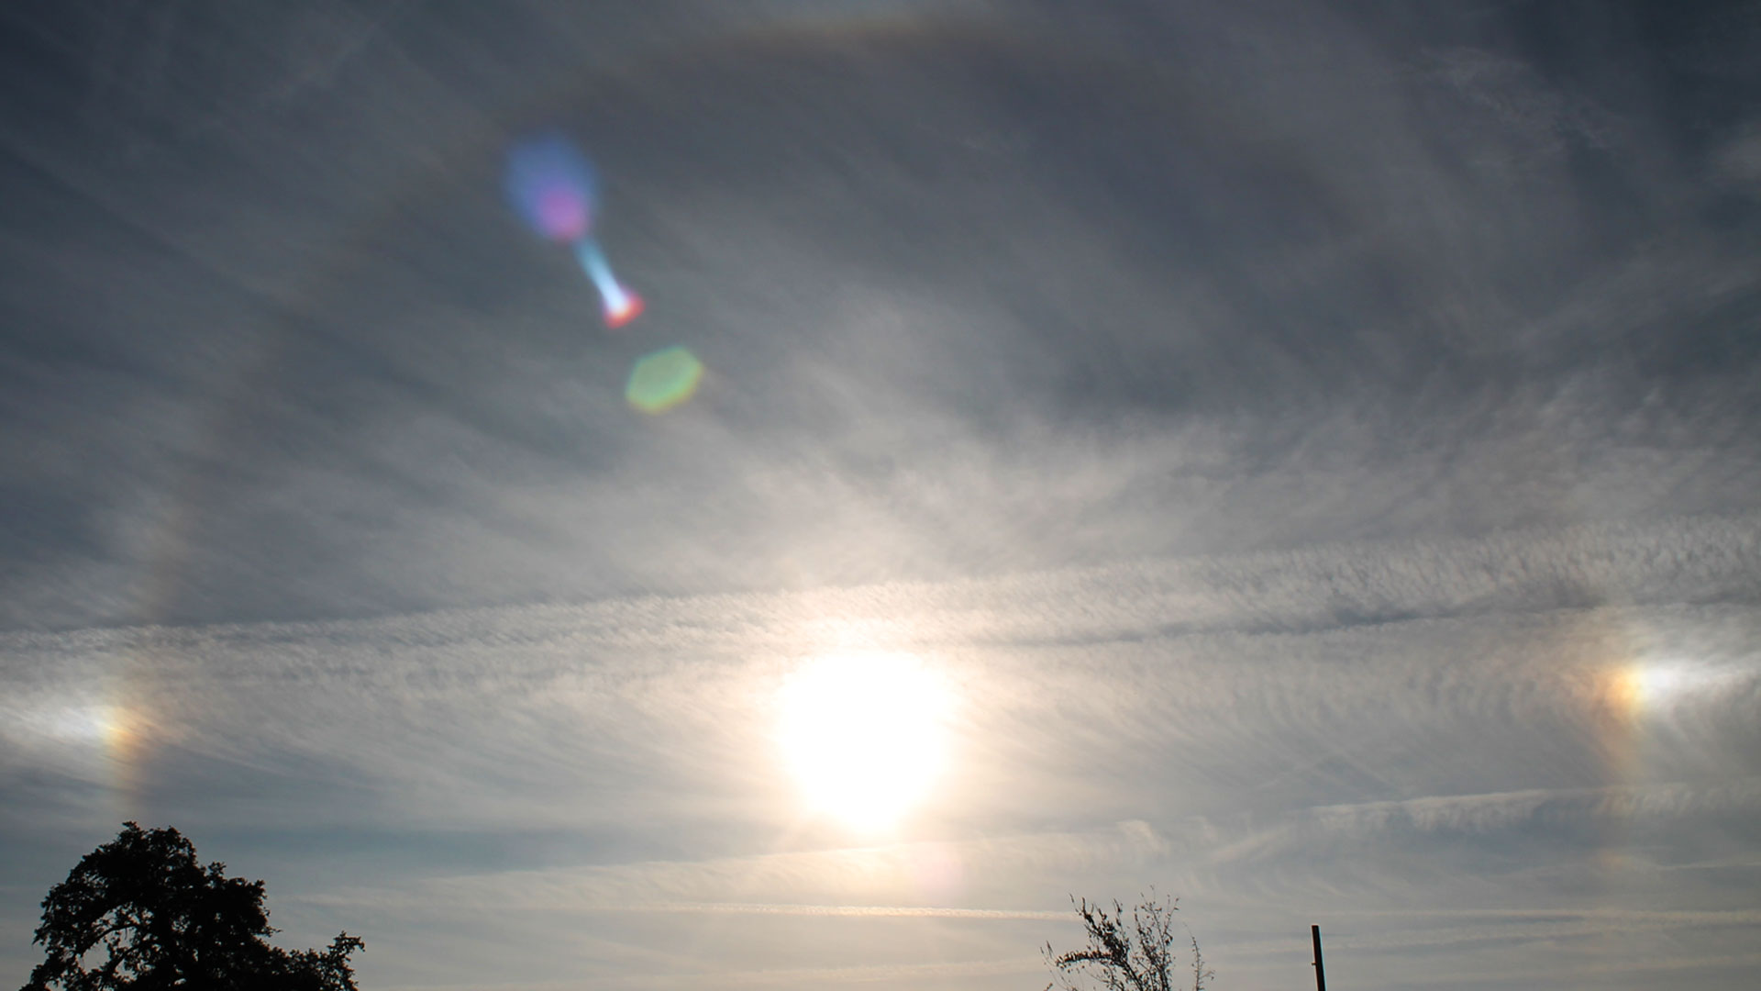
OZONE DESTRUCTION

Slide 7
OZONE DESTRUCTION
SOOT LEVITATS INTO THE STRATOSPHERE, CARRIES SULFUR & METALS
Though airborne, Black Carbon is known to dissipate and settle down in a few months under the influence of rain and wind and is unlikely to travel upward of 4 km. However, a group of scientists — including from the Indian Institute of Science and ISRO’s Vikram Sarabhai Space Centre — say they now have evidence of such particles existing up to 18 km into the stratosphere and there are about 10,000 of them in every cubic centimeter. Given the shape and location of these particles, they argue, it could only derive from emissions from aviation fuel and they pose a problem because these black carbon particles can linger long enough to provide a fertile ground for other chemical reactions that can deplete the ozone layer.
Govardhan, Gaurav, et al. “Possible climatic implications of high-altitude black carbon emissions.” Atmospheric Chemistry and Physics 17.15 (2017): 9623-9644.
Stratosphere
OZONE
“engineered nanoparticles could exploit photophoretic forces, enabling more control over particle distribution and lifetime than is possible with sulfates, perhaps allowing climate engineering to be accomplished with fewer side effects.”
Keith, David W. “Photophoretic levitation of engineered aerosols for geoengineering.” Proceedings of the National Academy of Sciences 107.38 (2010): 16428-16431.
PHOTOPHORETIC
LEVITATION
Troposphere
Black Carbon from Aircraft Exhaust is Destroying Ozone, Melting Poles https://climateviewer.com/2017/10/25/black-carbon-from-aircraft-exhaust-destroying-ozone-melting-poles/

Slide 8
OZONE DESTRUCTION
What happens if we lose our Ozone Layer? https://www.epa.gov/ozone-layer-protection/health-and-environmental-effects-ozone-layer-depletion
Harmful Ultra-Violet Radiation would kill all plant life on the planet. UVB radiation affects the physiological and developmental processes of plants. Despite mechanisms to reduce or repair these effects and an ability to adapt to increased levels of UVB, plant growth can be directly affected by UVB radiation.
Laboratory and epidemiological studies demonstrate that UVB causes non-melanoma skin cancer and plays a major role in malignant melanoma development. In addition, UVB has been linked to the development of cataracts.
Exposure to solar UVB radiation will kill marine life. Damage to Phytoplankton, early developmental stages of fish, shrimp, crab, amphibians, and other marine animals with implications for the whole marine food chain.
UVB radiation could affect terrestrial and aquatic biogeochemical cycles, thus altering both sources and sinks of greenhouse and chemically important trace gases (e.g., carbon dioxide, carbon monoxide, carbonyl sulfide, ozone, and possibly other gases).

Slide 9
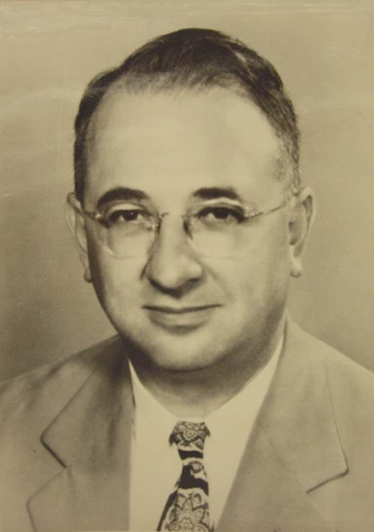
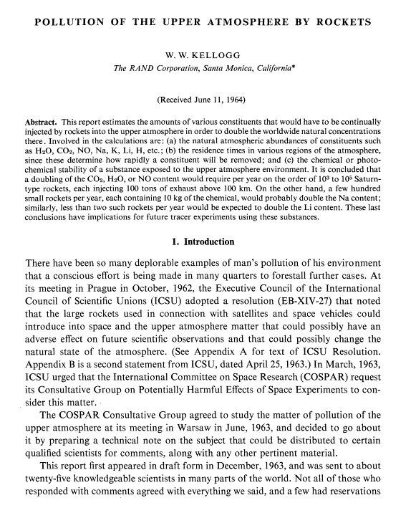
OZONE DESTRUCTION
HARRY WEXLER AND ROCKET EXHAUST - 1961
“Wexler was concerned that inadvertent damage to the ozone layer might occur if increased rocket exhaust polluted the stratosphere.”
Inadvertent
1. Increased pollution from rocket exhaust.
2. Near-space experiments could go awry, e.g. unknown risks of Operation Argus (1958), Project West Ford (1961), and Project Highwater (1962).
Purposeful
1. In 1934 S. Chapman proposed making a temporary “hole in the ozone layer” for the benefit of astronomers.
2. Possible military interest in waging geophysical warfare by attacking the ozone layer over a rival nation
“[Climate control] can best be classified as ‘interesting hypothetical exercises’ until the consequences of tampering with large scale atmospheric events can be assessed in advance. Most such schemes that have been advanced would require colossal engineering feats and contain the inherent risk of irremediable harm to our planet or side effects counterbalancing the possible short-term benefits.”
“On the Possibilities of Climate Control” in 1962: Harry Wexler on Geoengineering and Ozone Destruction – PowerPoint Presentation

Slide 10
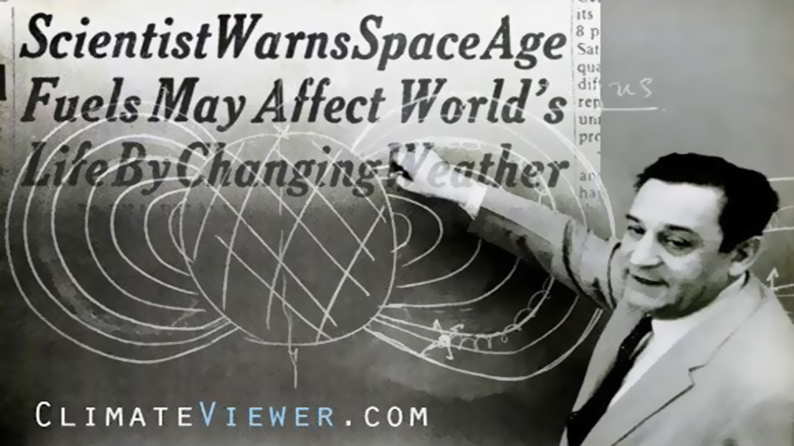
Watch on YouTube Chemtrails From SPACE! Sounding Rockets, Satellite Chemical Releases, and Ionospheric Heaters & check the references: Aluminum, Barium, and Chemtrails From Space!

Slide 11
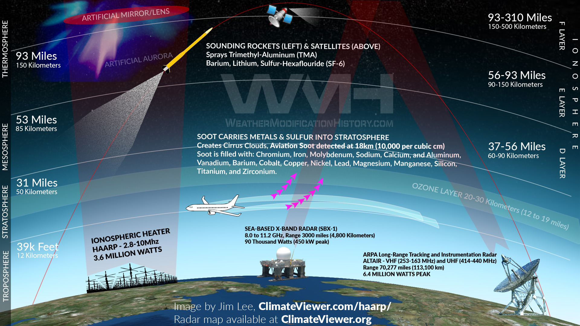

Slide 12
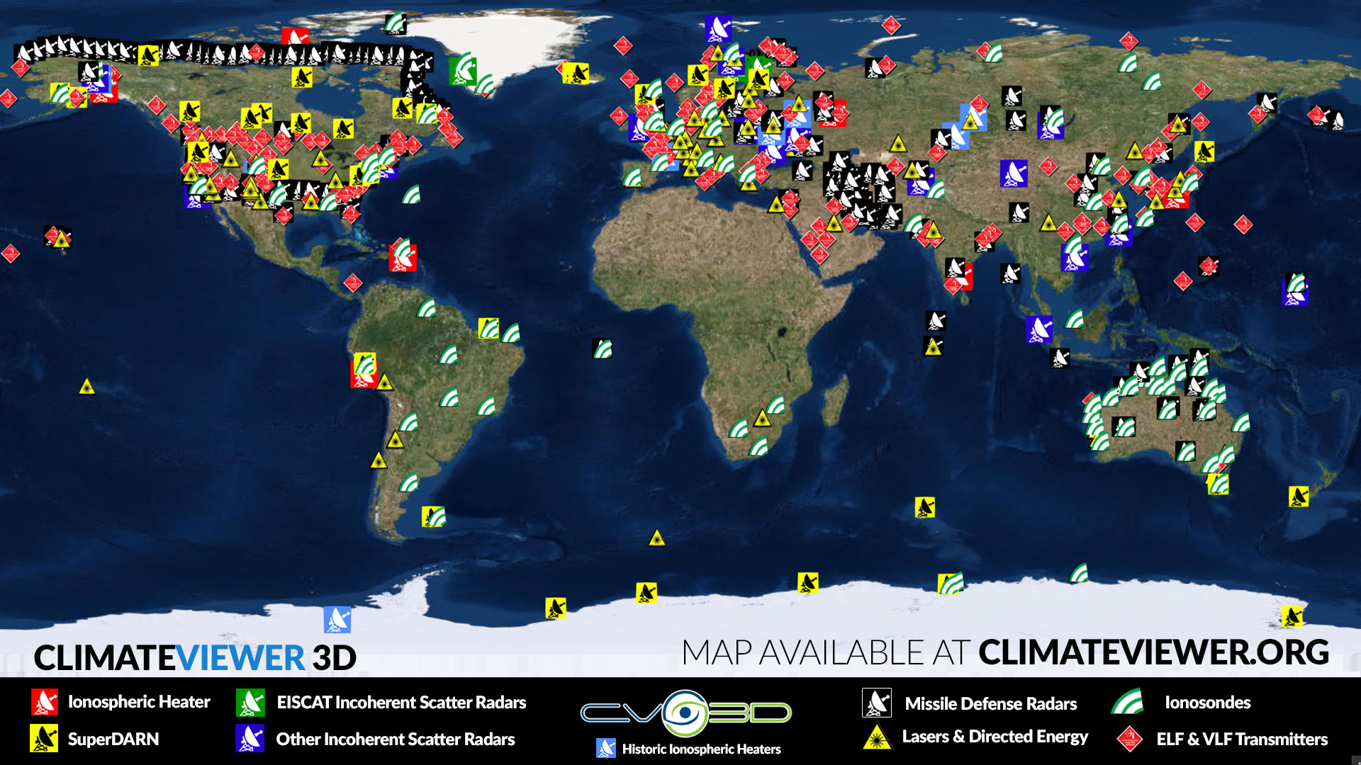

Slide 13
ARTIFICIAL CLOUD CREATION HISTORY

Slide 14
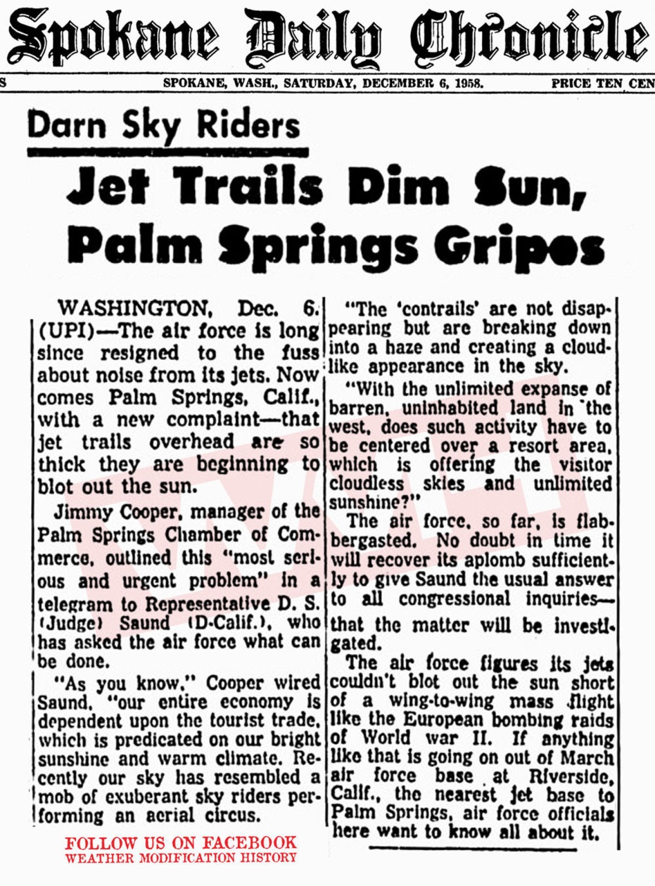
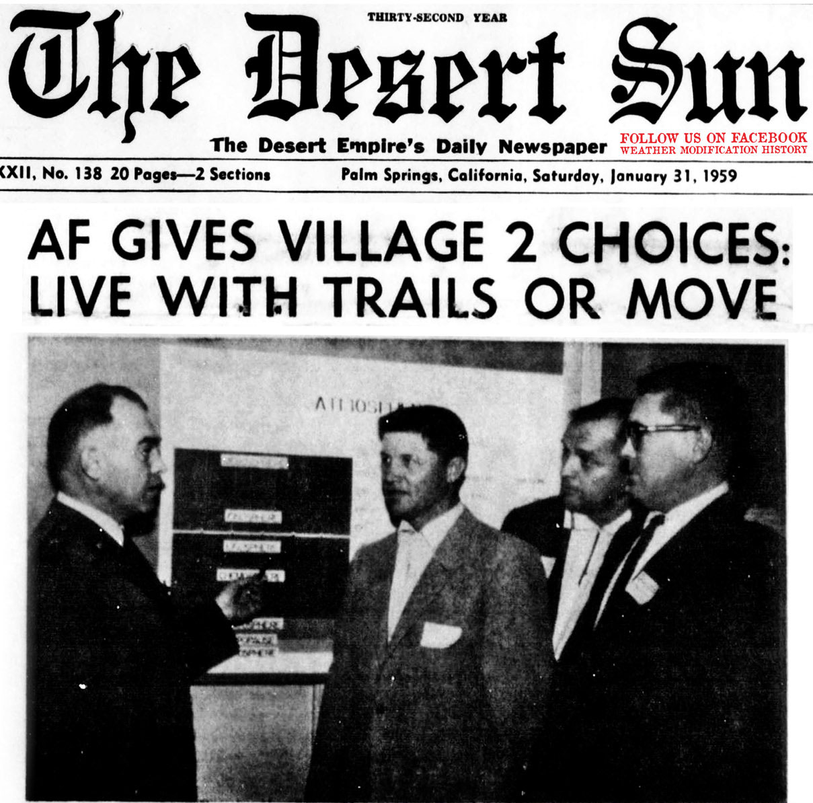
CARBON BLACK DUST & SOOT
A HISTORY LESSON - 1958
“Let’s face it, men” said a crisp talking, star-studded general, “you’ll either have to live with the vapor trails or move the City of Palm Springs.”
The resort area, it appears, is known as the “Palm Springs Intersection.” the freeway interchange of all West Coast aerial traffic.
So, the city officials and civic leaders, in an apparently unanimous, unspoken agreement, decided that a peaceful coexistence with the Air Force was the wisest course.
https://weathermodificationhistory.com/1948-contrail-cirrus-complaints-begin-nationwide/

Slide 15
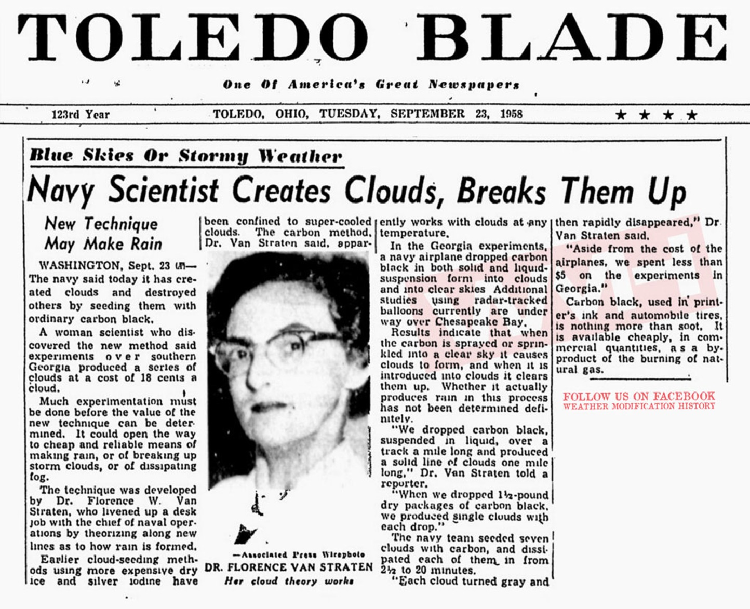
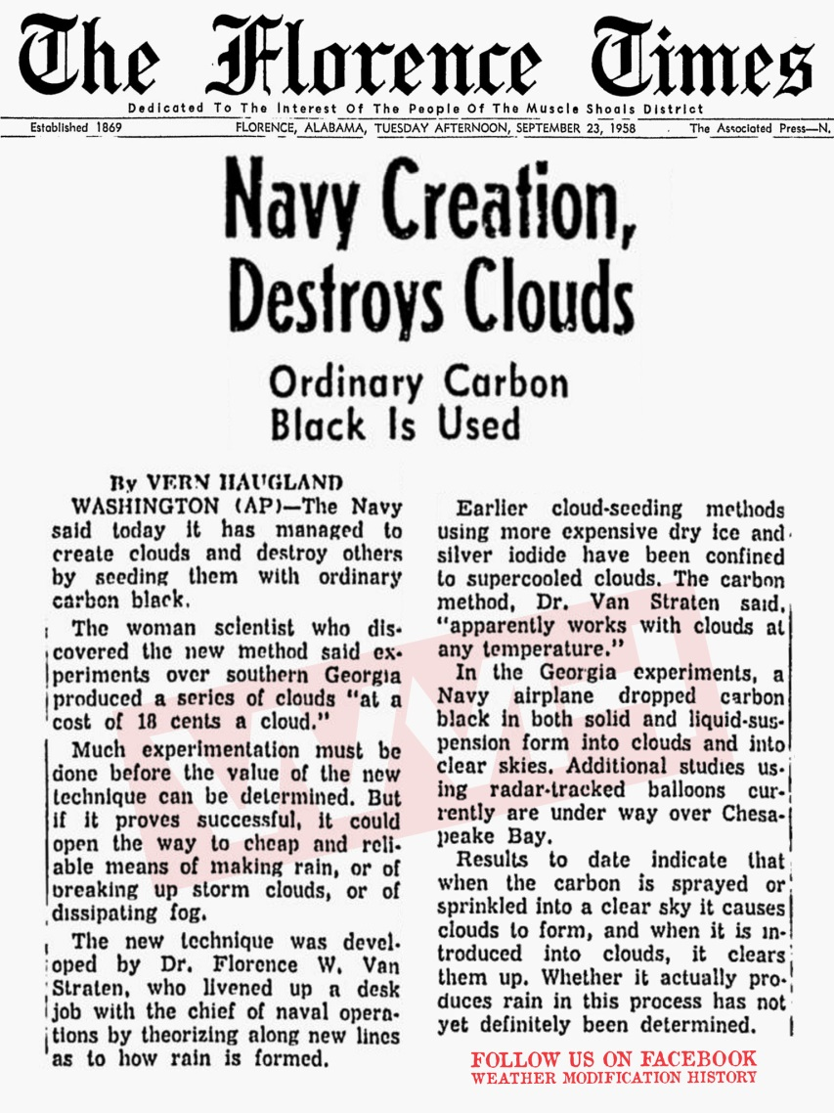
CARBON BLACK DUST
A HISTORY LESSON - 1958

Slide 16
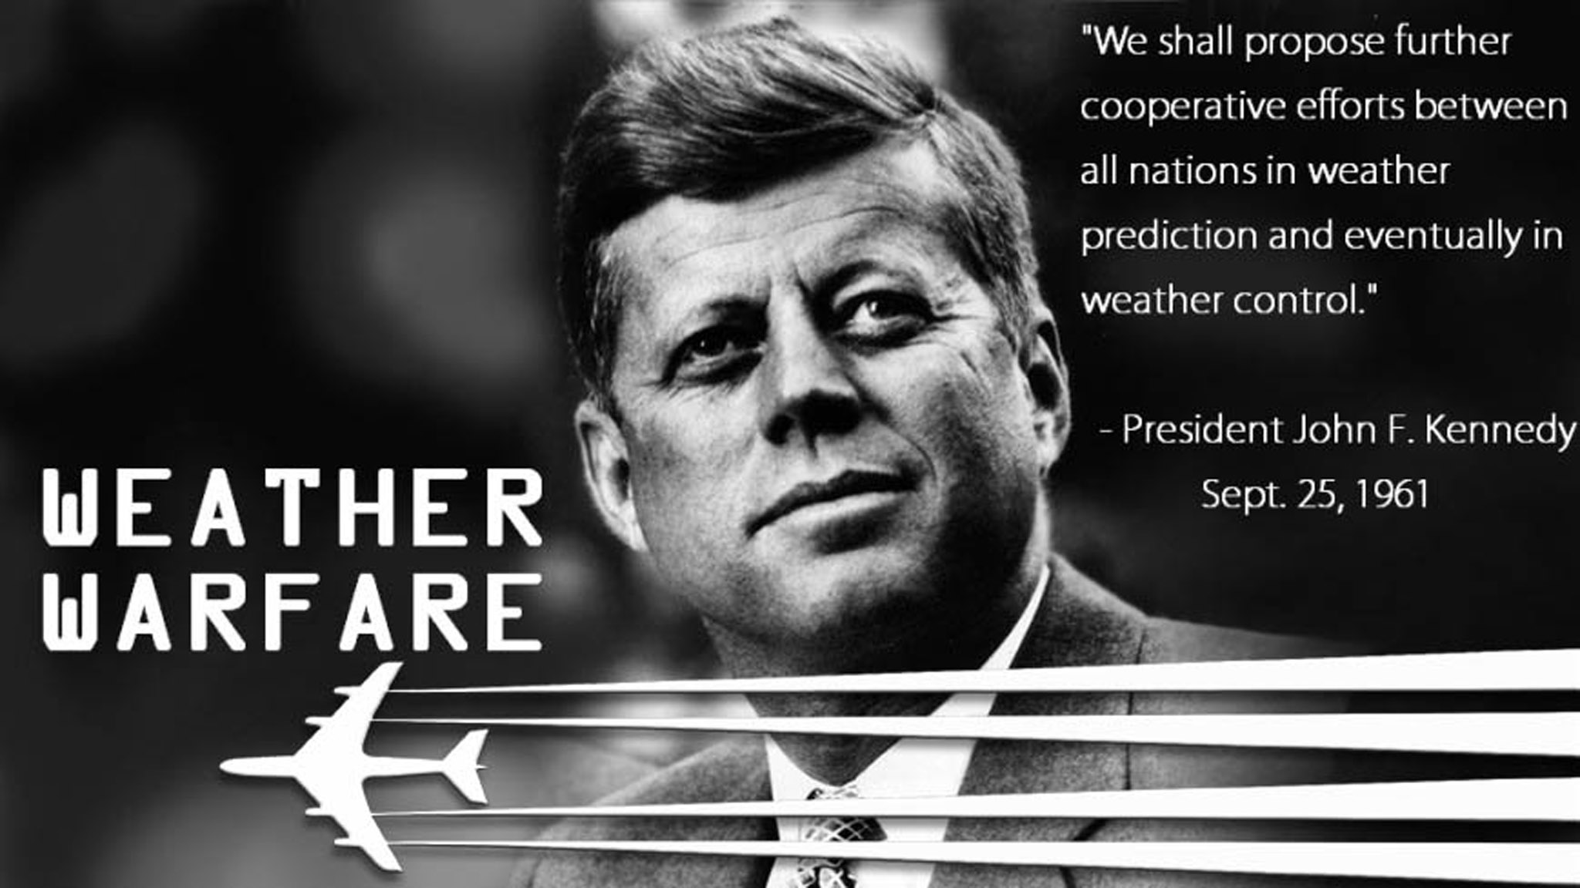
https://weathermodificationhistory.com/president-kennedy-united-nations-address-weather-modification/

Slide 17
CARBON BLACK DUST & SOOT
A HISTORY LESSON - 1962
“It lays the predicate and foundation for the development of a weather satellite that will permit man to determine the world's cloud layer and ultimately to control the weather; and he who controls the weather will control the world”
Vice President Johnson at Southwest Texas State University (1962)
https://weathermodificationhistory.com/president-lyndon-johnson-weather-wafare/

Slide 18
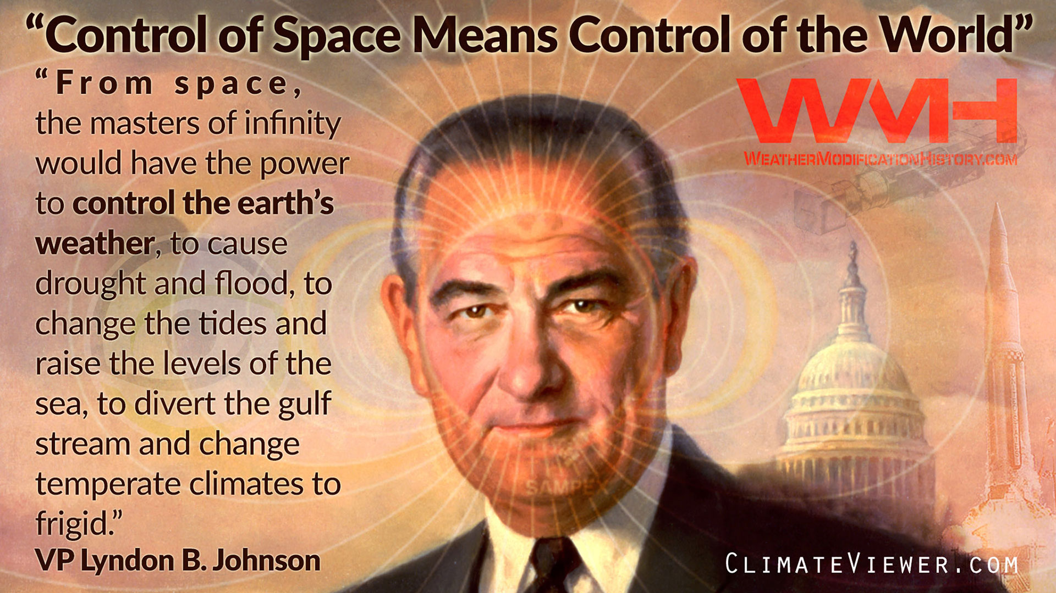

Slide 19
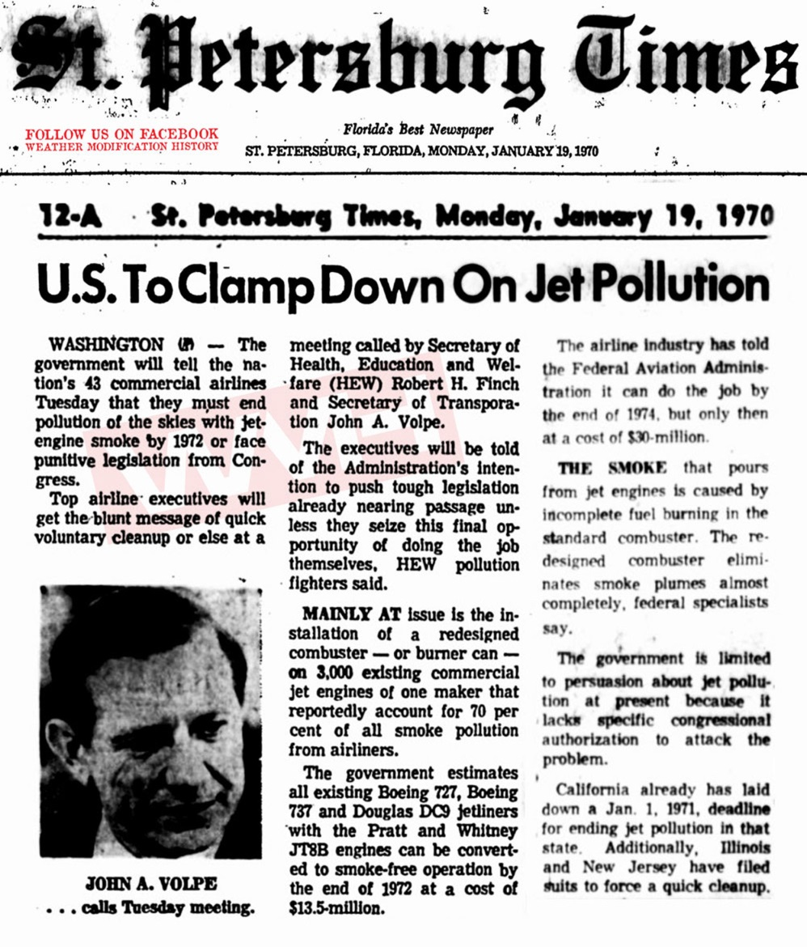
CARBON BLACK DUST & SOOT
A HISTORY LESSON - 1970
TWO STATES SUE OVER “BLACK BELCH” AND CIRRUS CLOUDS
“The government will tell the nation’s 43 commercial airlines Tuesday that they must end pollution of the skies with jet engine smoke by 1972 or face punitive legislation from Congress. Mainly at issue is the installation of a redesigned combuster – or burner can – on 3,000 existing commercial jet engines of one maker that reportedly account for 70 percent of all smoke pollution from airliners.
There will be a marked aesthetic improvement, since the so-called burner cans cut out something like 70 percent of the visible pollution and thus the familiar “black belch” will be seen no more.”
https://weathermodificationhistory.com/states-sue-airlines-over-smoke-pollution-of-the-skies/

Slide 20
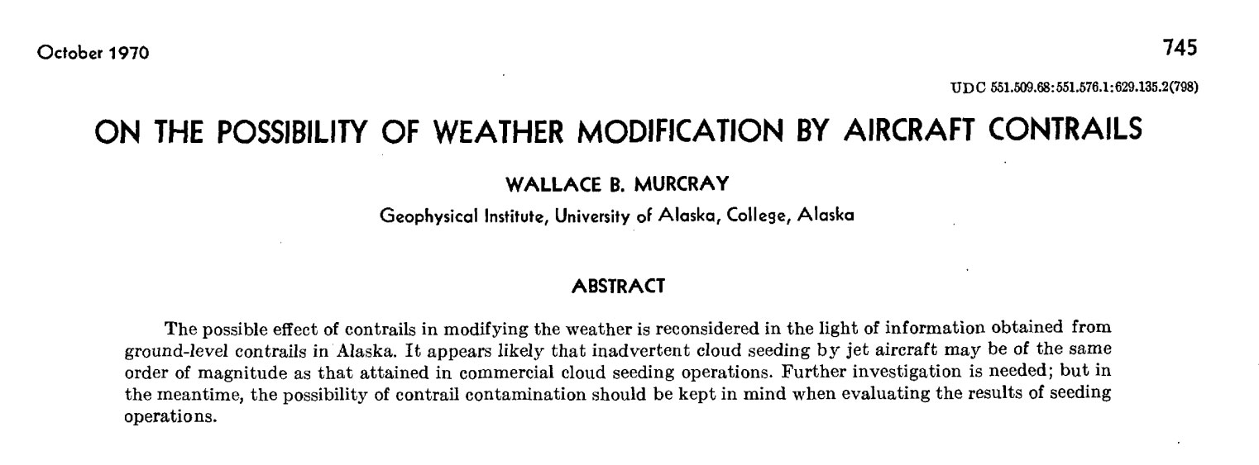
CARBON BLACK DUST & SOOT
A HISTORY LESSON - 1970
“likely contrails are affecting precipitation to a much greater extent than are present deliberate seeding operations.”
Murcray, Wallace B. "On the possibility of weather modification by aircraft contrails." Mon. Wea. Rev 98.10 (1970): 745-748.

Slide 21
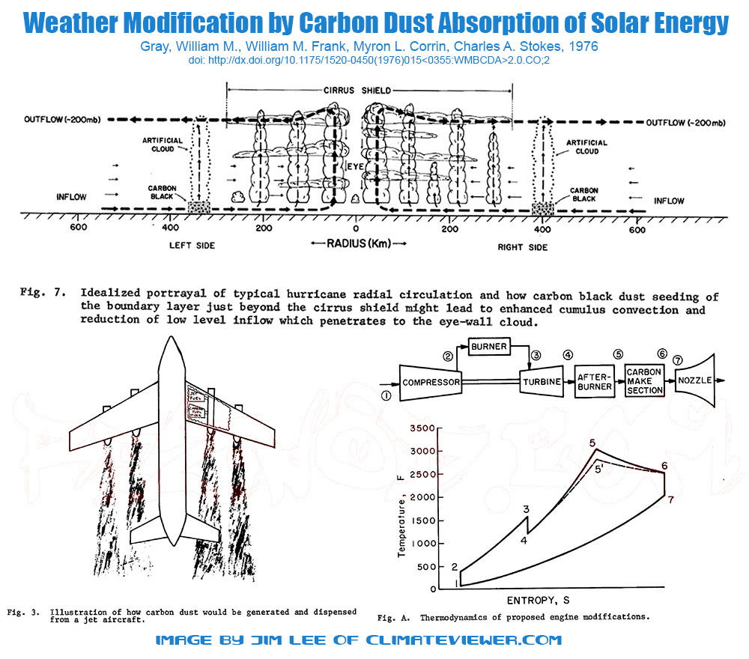
CARBON BLACK DUST & SOOT
A HISTORY LESSON - 1974
“Growing global population pressures and predicted future food shortages dictate that man fully explore his potential use of solar energy. ... Interest is concentrated on the feasibility of mesoscale (~ 100-300 km) weather modification through solar energy absorption by carbon aerosol particles of the size ~ 0.1 µm [micrometer, 100 nanometer] or less”
Gray, William M., et al. "Weather modification by carbon dust absorption of solar energy." Journal of Applied Meteorology15.4 (1976): 355-386.

Slide 22
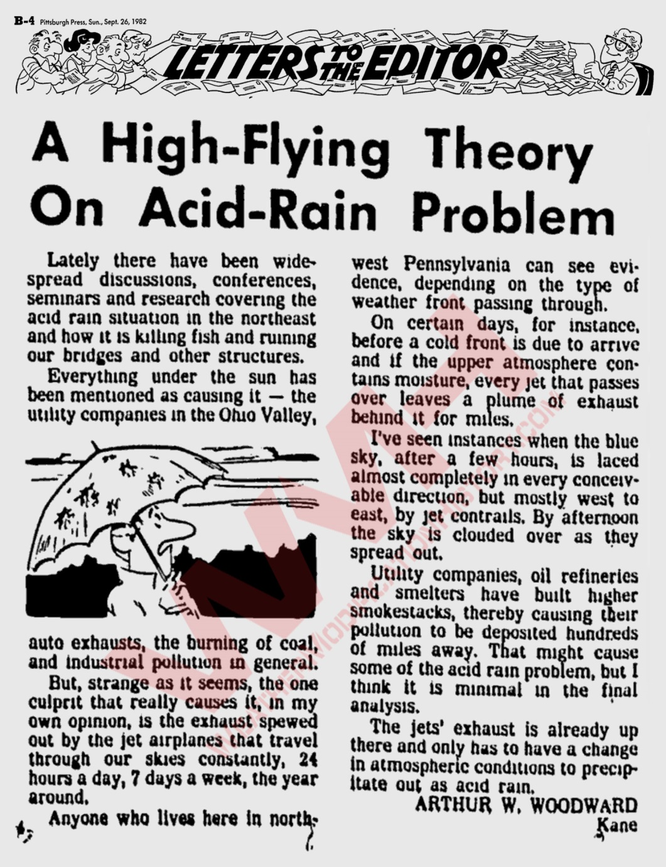
CARBON BLACK DUST & SOOT
A HISTORY LESSON - 1982
“…the one culprit that really causes it, in my own opinion, is the exhaust spewed out by the jet airplanes that travel through our skies constantly…
I’ve seen instances when the blue sky, after a few hours, is laced almost completely in every conceivable direction, but mostly west to east, by jet contrails. By afternoon the sky is clouded over as they spread out.
The jets’ exhaust is already up there and only has to have a change in atmospheric conditions to precipitate out as acid rain.”
https://news.google.com/newspapers?nid=1144&dat=19820925&id=ZeEhAAAAIBAJ&sjid=-V4EAAAAIBAJ&pg=1968%2C4220475&hl=en

Slide 23
WEATHER WARFARE

Slide 24
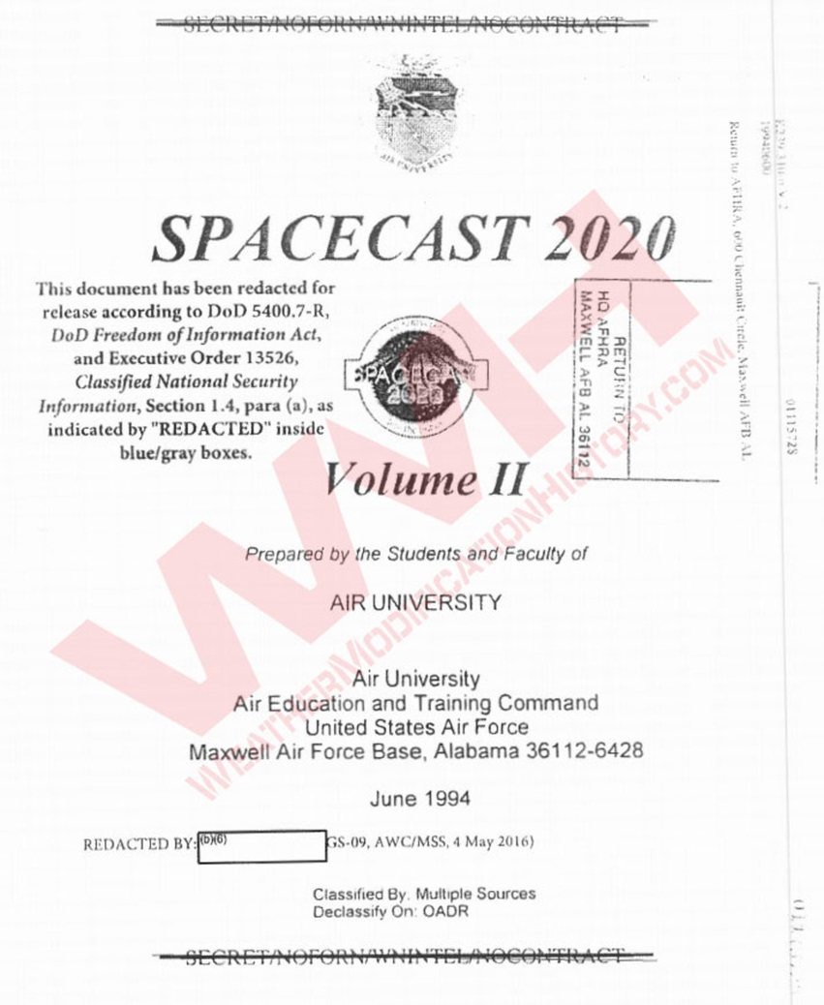
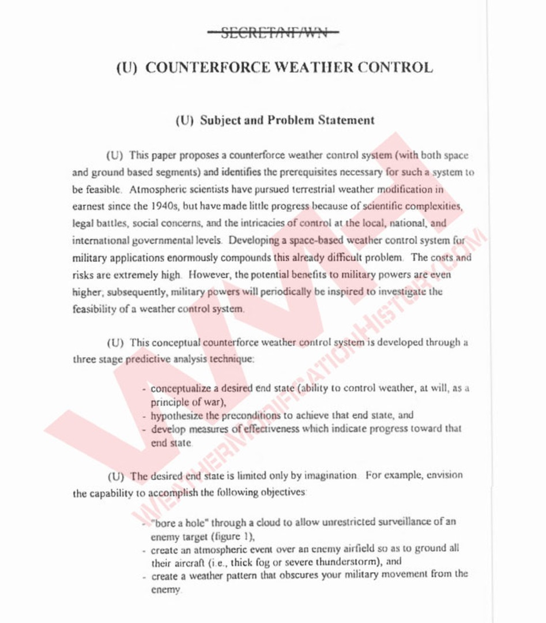
CARBON BLACK DUST
A HISTORY LESSON - 1994
(U) Previous USSR Weather Modification Efforts
- REDACTED -
“This demonstrated an ability to generate infrared-defeating clouds, effectively denying overhead surveillance.”
https://weathermodificationhistory.com/foia-reveals-usaf-paper-counterforce-weather-control-spacecast-2020/

Slide 25
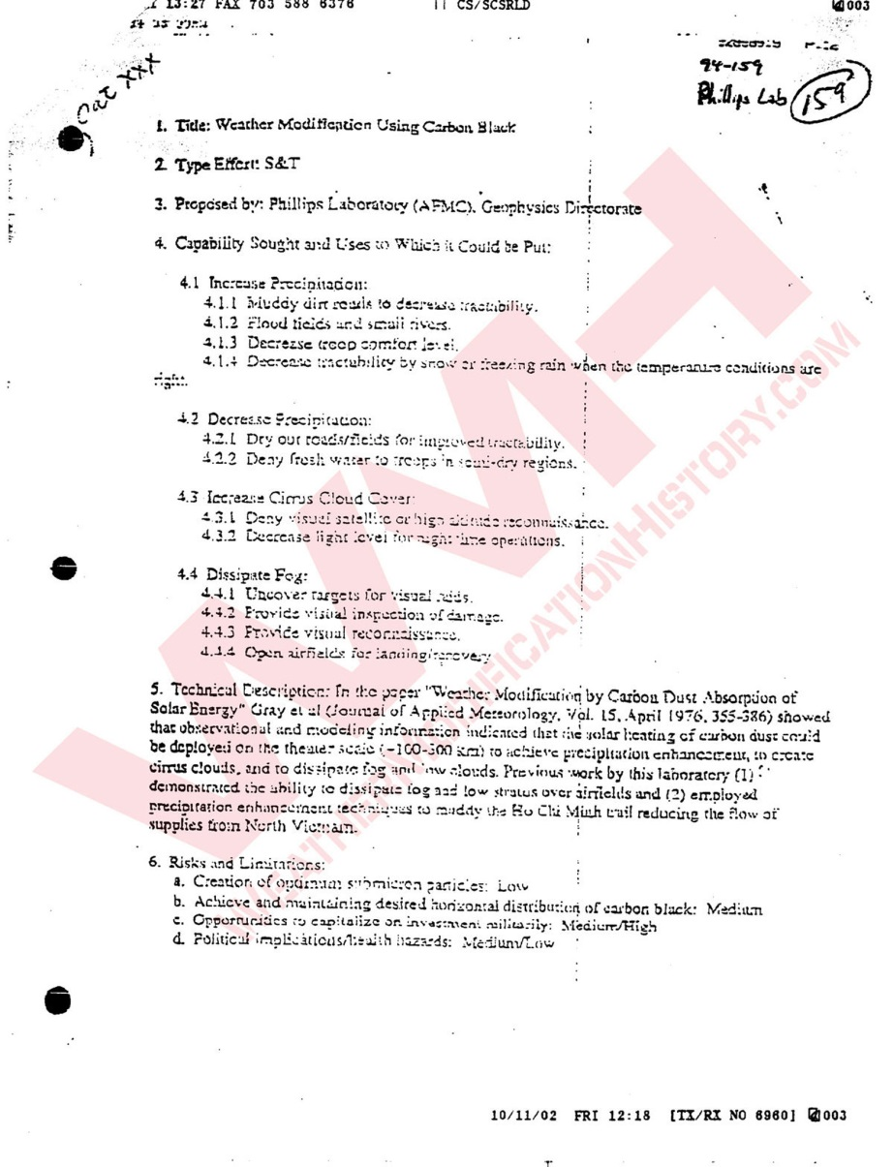
CARBON BLACK DUST
A HISTORY LESSON - 1994
US Air Force Freedom of Information Act (FOIA) Document:
TITLE: Weather Modification Using Carbon Black
PROPOSED BY: Phillips Laboratory (AFMC), Geophysics Directorate Technical
Description: In the paper "Weather Modification by Carbon Dust Absorption of Solar Energy" Gray el al (Journal of Applied Meteorology, Vol 15, April 1976, 355-386) showed that observational and modeling information indicated that the solar heating of carbon dust could be deployed on the theatre scaled (~100-300km) to achieve precipitation enhancement, to create cirrus clouds, and to dissipate fog and low clouds. Previous work by this laboratory:
demonstrated the ability to dissipate fog and low stratus over airfields and
employed precipitation enhancement techniques to muddy the Ho Chi Minh trail reducing the flow of supplies from North Vietnam. Risks and Limitations: a. Creation of optimum submicron particles: Low b. Achieve and maintaining desired horizontal distribution of carbon black: Medium c. Opportunities to capitalize on investment militarily: Medium/High d. Political implications/health hazards: Medium/Low
Project Plan - Major Milestones a. Numerical model studies completed 1996 b. Engineering design of test engine mod. 1997 c. Ground-based field trials completed. 1999 d. Airborne test and evaluation of prototypes completed 2001 e. Engineering design for airborne carbon black delivery system completed 2003 f. Operational capability 2004 Rough estimate of the total cost to operational capability: $23.5 million. Life cycle costs have not been estimated.
https://weathermodificationhistory.com/foia-reveals-us-air-force-geophysics-directorate-weather-modification-intentions/

Slide 26
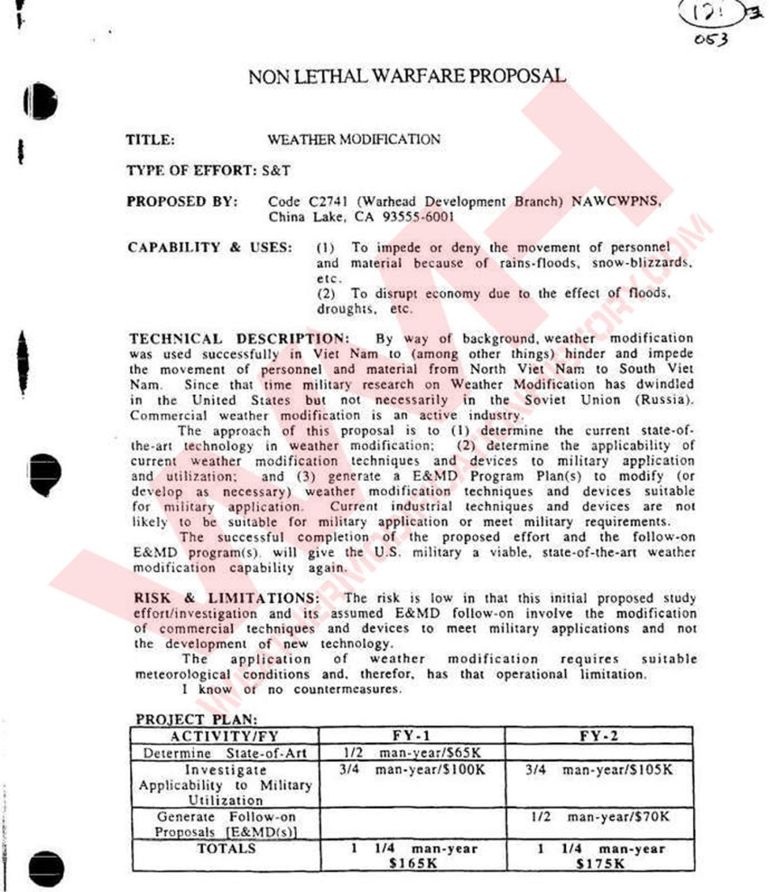
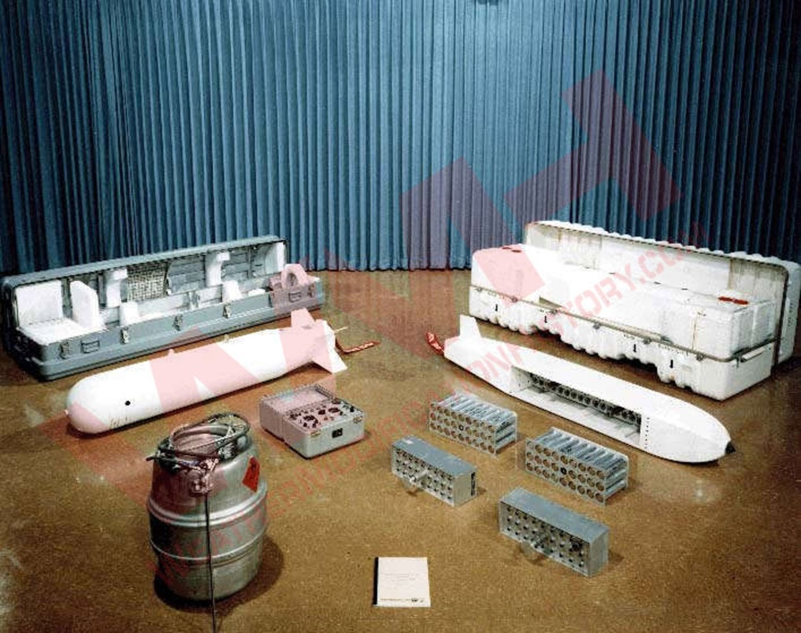
CARBON BLACK DUST
A HISTORY LESSON - 1994
US Navy Freedom of Information Act (FOIA) Document:
TITLE: NON-LETHAL WARFARE PROPOSAL, WEATHER MODIFICATION
PROPOSED BY: Code C2741 (Warhead Development Branch) NAWCWPNS, China Lake CA 93555-6001
CAPABILITY & USES:
To impede or deny the movement of personnel and material because of rains-floods, snow-blizzards, etc.
To disrupt economy due to the effect of floods, droughts, etc.
“successful completion of the proposed effort and the follow-on E&MD program(s) will give the U.S. military a viable, state-of-the-art weather modification capability again. ...
I know of no countermeasures.”
Cold Cloud Modification System bombs developed by US. Navy China Lake Weapons Branch for use in Vietnam’s “Operation Popeye”
https://weathermodificationhistory.com/foia-reveals-us-navy-weather-modification-program-still-active-china-lake/

Slide 27
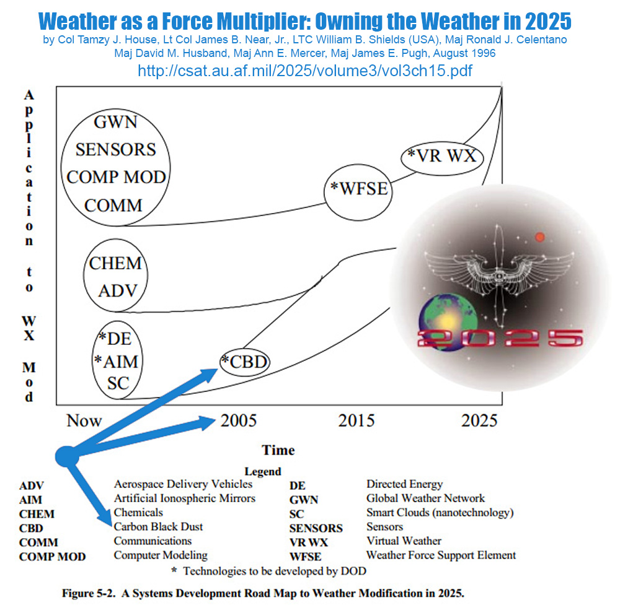
CARBON BLACK DUST
A HISTORY LESSON – 1995-1996
TITLE: Weather as a Force Multiplier: Owning the Weather in 2025
Carbon Black Dust (2005) to be developed by Department of Defense
To achieve the core capabilities depicted in figure 5-1, the necessary technologies and systems might be developed according to the process depicted in figure 5-2. This figure illustrates the systems development timing and sequence necessary to realize a weather-modification capability for the battlespace by 2025. The horizontal axis represents time. The vertical axis indicates the degree to which a given technology will be applied toward weather-modification. As the primary users, the military will be the main developer for the technologies designated with an asterisk. The civil sector will be the main source for the remaining technologies.
https://weathermodificationhistory.com/weather-as-force-multiplier-owning-the-weather-in-2025/

Slide 28
CARBON BLACK DUST
A HISTORY LESSON – 1997
TEST TECHNOLOGY SYMPOSIUM ‘97 “THE ARMY AFTER NEXT,­ HOW WILL WE TEST?” WEATHER MODIFICATION Dr. Arnold Barnes, Jr.
Phillips Lab/GPO, Hanscom Air Force Base, MA
“The difficulty, cost, and risk of developing a weather control system for military applications are extremely high. However, the potential benefits for national security could be even higher. Enemy weather modification weapons are possibilities which, like it or not, may be possible and must be considered,” Spacecast 2020. This paper considers such concepts as hole boring for surveillance; the use of space mirrors for night battlefield illumination, modifying the environment, enforcement of curfews and similar civil control measures; use of carbon black to retarget precipitation; fog dissipation; and cirrus enhancement.
https://climateviewer.com/2013/11/16/us-military-discusses-future-of-weather-warfare-despite-enmod-ban/

Slide 29
CARBON BLACK DUST
A HISTORY LESSON – 1997
WEATHER MODIFICATION USING CARBON BLACK (1) - Increase Precipitation - Muddy dirt roads to decrease tractability - Flood fields and small rivers - Decrease troop comfort level - Decrease tractability by snow or freezing rain when the temperature conditions are right - Decrease Precipitation # - Dry out roads/fields for improved tractability - Deny fresh water to troops in semi-dry regions Notes: The following is an example of the use of one particular seeding agent* to modify the weather. This information was provided to the Office of the Under Secretary of Defense (A&T) on a request for ideas for Non-Lethal Technologies and Weapons which “avoided or minimized the loss of life and associated damage.”
https://climateviewer.com/2013/11/16/us-military-discusses-future-of-weather-warfare-despite-enmod-ban/

Slide 30
CARBON BLACK DUST
A HISTORY LESSON – 1997
CLOUD SEEDING (cont.) WEATHER MODIFICATION USING CARBON BLACK (2) Increase Cirrus Cloud Cover - Deny visual satellite or high altitude reconnaissance - Decrease light level for night time operations
Dissipate Fog - Uncover targets for visual raids - Provide visual inspection of damage - Provide visual reconnaissance - Open airfields for landing / recovery
Notes: Project Plan: MAJOR MILESTONES not funded • Numerical model studies completed 1997 • Engineering design of test engine model 1998 • Ground-based field trials completed 2000 • Airborne T&E of prototype completed 2002 • Engineering design for airborne carbon black delivery system completed 2004
Build upon (1) NOAA's “Atmospheric Modification Program” (AMP), a joint NOAA/States effort written into NOAA's budget every year by Congress, (2) the Illinois State Water Survey studies of inadvertent weather modification, and (3) articles in the Journal of Weather Modification.
https://climateviewer.com/2013/11/16/us-military-discusses-future-of-weather-warfare-despite-enmod-ban/

Slide 31
NATO “SINGLE FUEL CONCEPT”
A HISTORY LESSON – 1988-1997
https://climateviewer.com/2014/11/05/contrails-geoengineering-single-fuel-concept/

Slide 32
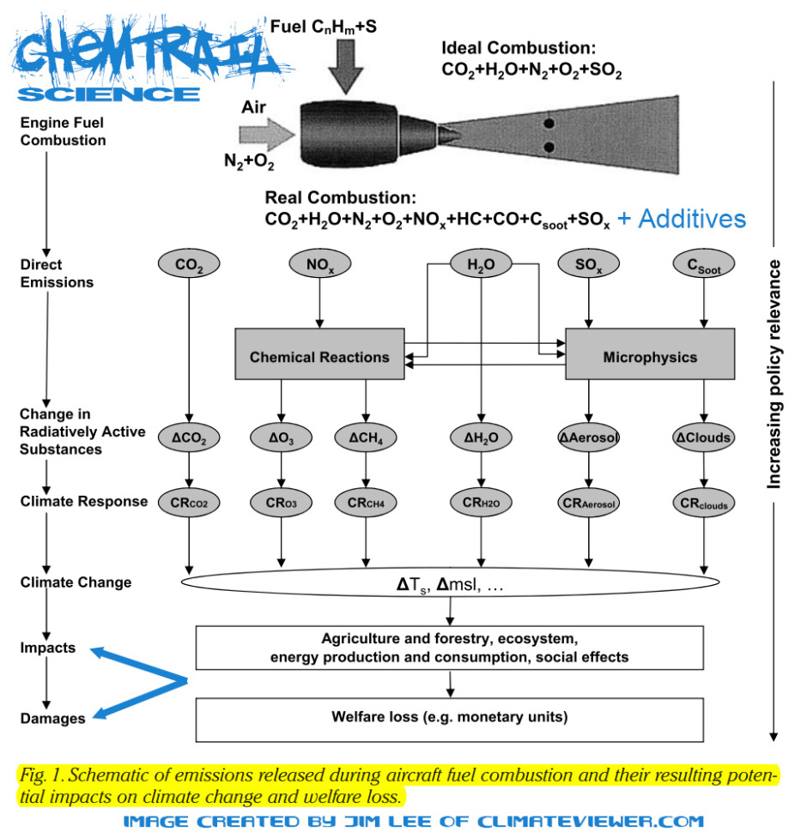
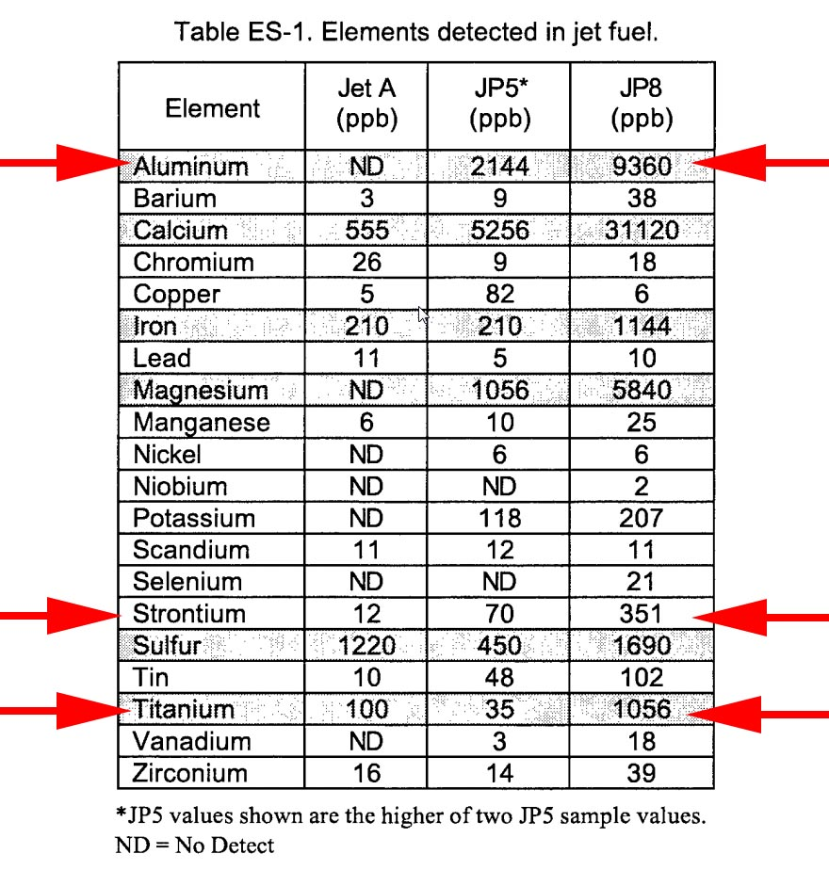
NATO “SINGLE FUEL CONCEPT”

Slide 33
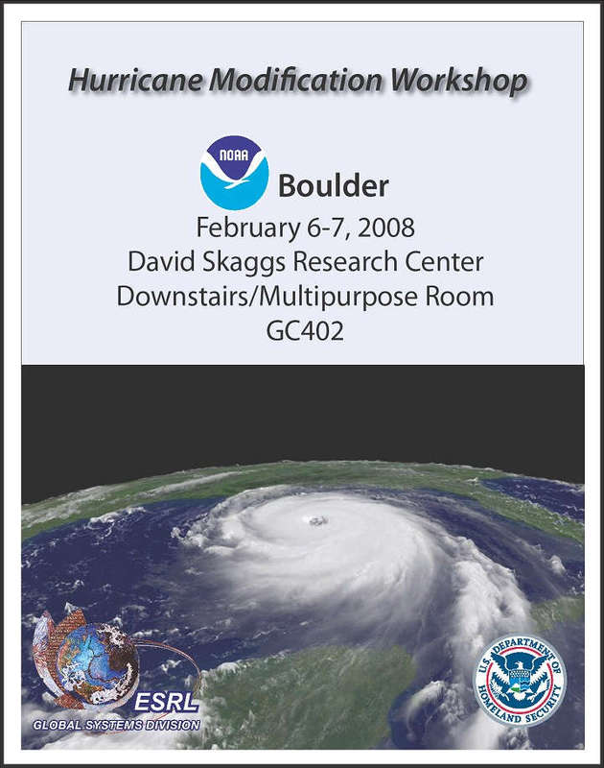
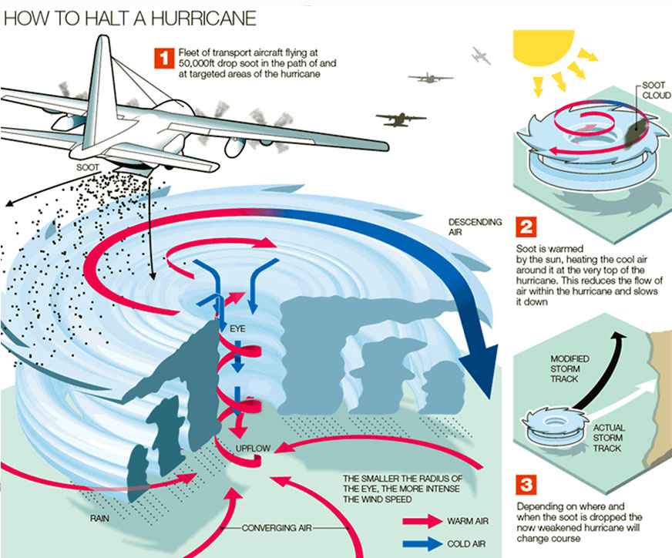
CARBON BLACK DUST & SOOT
A HISTORY LESSON - 2008
Collaborative Research: On Hurricane Modification by Carbon Black Dispersion: Methods, Risk Mitigation, and Risk Communication – Dr. Moshe Alamaro
This presentation focused on the use of carbon black aerosol (CBA) to selectively heat parts of the atmosphere by dispersion of CBA above a hurricane. This scenario is motivated by the fact that the energy cycle of a hurricane may be represented as a Carnot heat engine, and reducing the contrast between “hot and cold reservoirs” should reduce the power of a hurricane and the CBA will absorb incident solar radiation to warm the “cold reservoir.”
Objectives of this study are to demonstrate direct control of the intensity or track of simulated hurricanes;
to quantify amounts of CBA needed; to enhance understanding of the web of physical processes that power hurricanes in relation to the overall thermodynamics of hurricanes;
to determine optimal dispersion scenarios;
to enhance understanding of the radiative and flow properties of CBA;
to establish causes, effects, and outcomes of CBA dispersion;
and to develop methods to communicate risk to the public of large-scale weather modification efforts.
https://climateviewer.com/2013/11/08/hurricane-hacking-the-department-of-homeland-security-enters-the-weather-modification-business/

Slide 34
CONTRAIL CONTROL

Slide 36
CARBON BLACK DUST & SOOT
A HISTORY LESSON - 2001
All flights were grounded after the September 11, 2001 attacks on the twin towers. A team of NASA scientists noticed that it got much colder that night than usual. They came to the conclusion that cirrus clouds generated by aircraft contrails were trapping heat at night. This study changed world and sent the airline industry into a tail spin trying to figure out how to deal with their contrail conundrum. It is possible that aircraft contrail induced cirrus clouds are trapping more heat than their CO2 emissions meaning the airline industry could incur hefty carbon tax charges if they don’t create “less warming and more cooling clouds.”
Before 9/11/2001, one could make the argument that contrails creating clouds was just pollution. After this monumental study, scientists and geoengineers have been trying to figure out how to alter jet fuel> to create clouds that ONLY cool the planet and have no intention on stopping the creation of artificial clouds or removing these clouds all together.
https://weathermodificationhistory.com/september-11-2001-airline-groundings-contrails-affect-daily-temperature-range/
Travis, David J., Andrew M. Carleton, and Ryan G. Lauritsen. "Regional variations in US diurnal temperature range for the 11–14 September 2001 aircraft groundings: Evidence of jet contrail influence on climate." Journal of climate 17.5 (2004): 1123-1134.

Slide 37
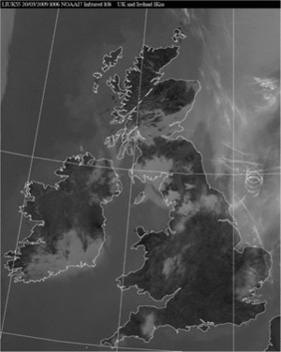
CARBON BLACK DUST & SOOT
A HISTORY LESSON - 2009
Volcanic Eruption Highlights Contrail Conundrum
“A single aircraft operating in conditions favorable for persistent contrail formation appears to exert a contrail-induced radiative forcing some 5000 times greater (in W m−2 km−1) than recent estimates of the average persistent contrail radiative forcing from the entire civil aviation fleet.”
Haywood, J. M., R. P. Allan, J. Bornemann, P. Forster, P. N. Francis, S. Milton, G. Rädel, A. Rap, K. P. Shine, and R. Thorpe (2009), A case study of the radiative forcing of persistent contrails evolving into contrail-induced cirrus, J. Geophys. Res., 114, D24201, doi:10.1029/2009JD012650.
https://weathermodificationhistory.com/volcanic-eruption-highlights-contrail-conundrum/

Slide 38
CARBON BLACK DUST & SOOT
A HISTORY LESSON - 2011
Cirrus Clouds > Greenhouse Gases
“Contrails formed by aircraft can evolve into cirrus clouds indistinguishable from those formed naturally. These ‘spreading contrails’ may be causing more climate warming today than all the carbon dioxide emitted by aircraft since the start of aviation.”
Both ground- and satellite-based cloud observations have suggested a small but noticeable increase in cirrus cloud cover in regions of high air-traffic density relative to adjacent regions. However, contrail spreading is not the only mechanism that could explain this increase. It has also been suggested that aircraft-emitted aerosols could serve as ice nuclei and facilitate the formation of cirrus cloud. To understand the impact of aviation on climate, it is necessary to quantify the importance of these two mechanisms.
Boucher, Olivier. "Atmospheric science: Seeing through contrails." Nature Climate Change 1.1 (2011): 24. - PDF

Slide 39
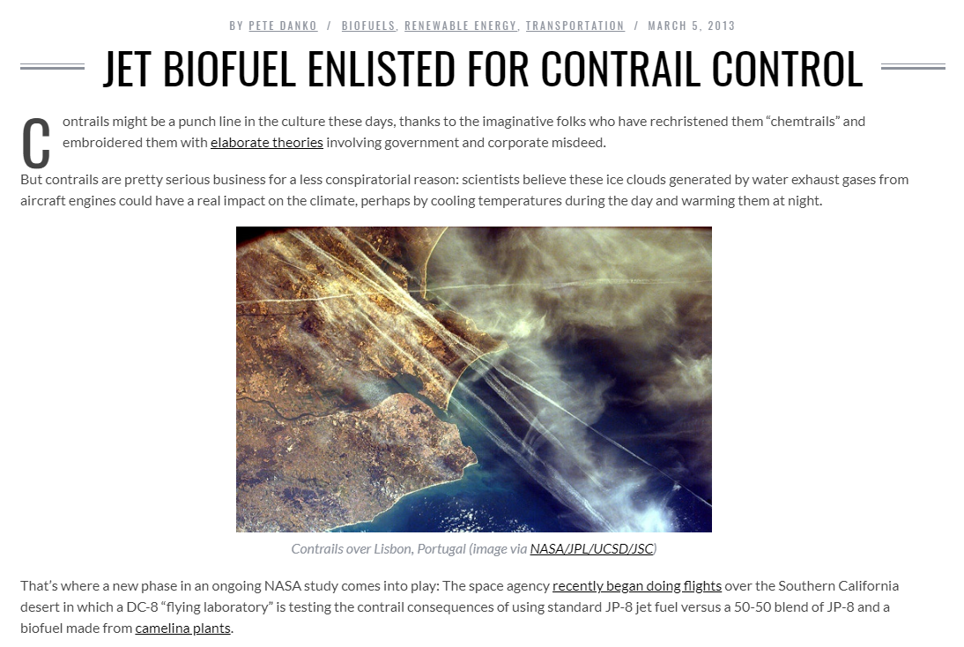
https://weathermodificationhistory.com/jet-biofuel-enlisted-for-contrail-control/

Slide 40
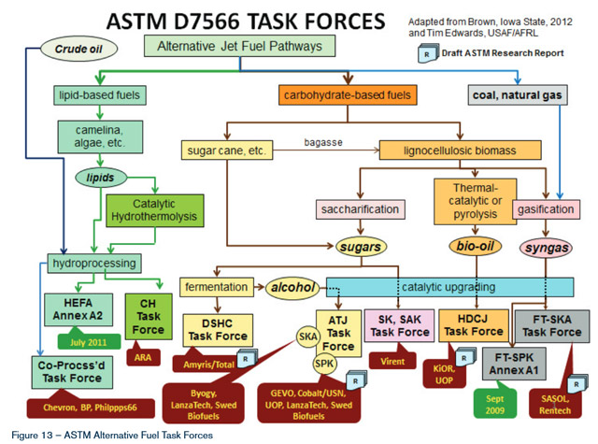
BIOFUELS FOR CONTRAIL CONTROL
ADDING ALUMINUM NANO-PARTICLES TO JET FUEL
Why add nanoparticles? The idea, says lead author R. B. Anand, an associate professor of mechanical engineering at the National Institute of Technology in Tiruchirappalli, India, is that because of their high surface-to-volume ratio, the nanoparticles—which, in the study, had an average diameter of 51 billionths of a meter—have more reactive surfaces, allowing them to act as more efficient chemical catalysts, thus increasing fuel combustion. The presence of the particles also increases fuel–air mixing in the fuel, which leads to more complete burning. In the study, Anand and co-author J. Sadhik Basha first used a mechanical agitator to create an emulsion consisting of jatropha biodiesel (a fuel derived from the crushed seeds of the jatropha plant), water, and a surfactant, then blended in different proportions of alumina nanoparticles. In addition to outperforming regular biofuel, the nanoparticle-spiked fuels produced significantly lower quantities of nitrogen oxide and carbon monoxide gases, and created less smoke. The researchers are now testing other types of nanoparticles, including hollow carbon nanotubes, and investigating the effects of nano-additives to engine lubrication and cooling systems. One obstacle to the application of this kind of nanotechnology is the high cost of nanoparticle production, says Anand—who also cautions that nanoparticles "should be used judiciously," because they tend to "entrain into human bodies.“
Sadhik Basha, J., and R. B. Anand. "Role of nanoadditive blended biodiesel emulsion fuel on the working characteristics of a diesel engine." Journal of Renewable and Sustainable energy 3.2 (2011): 023106.

Slide 41
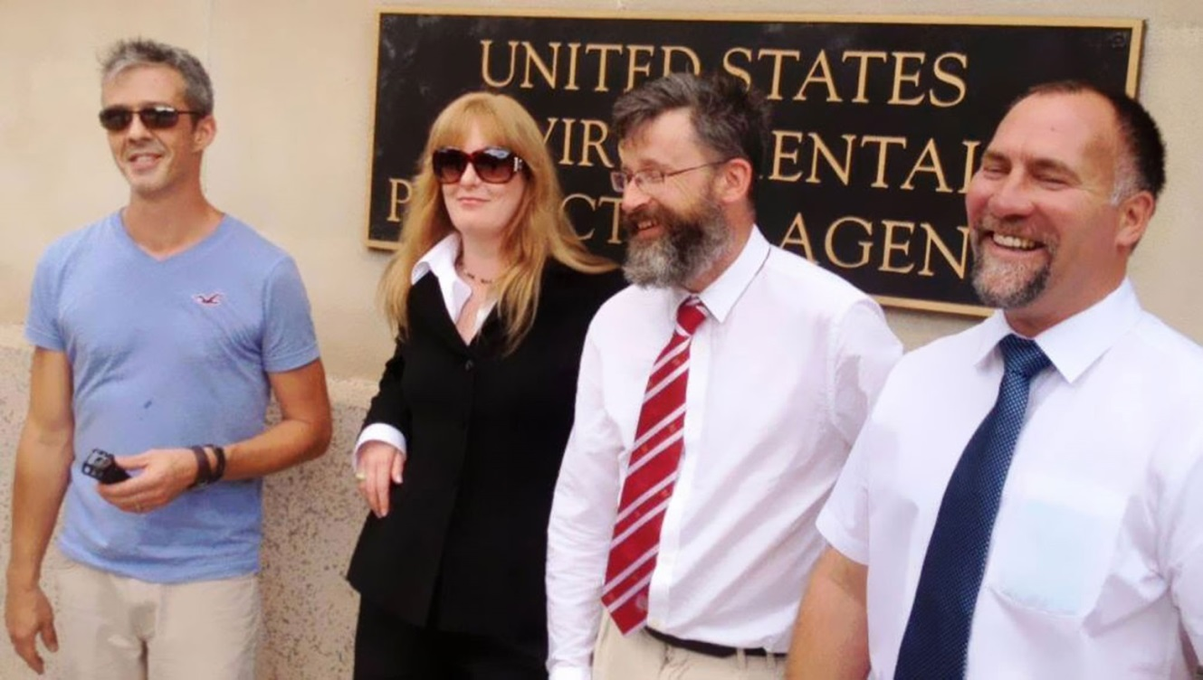
ACTIVISTS FIGHT BACK
A HISTORY LESSON – 2015 - VIDEO
August 11, 2015 – EPA Hearing on Commercial Aircraft Emissions
Jim Lee, Max Bliss, Patrick Roddie, Michael Saraceno, and Amanda Baise speak at the world’s first EPA hearing on flight pollution. The Environmental Protection Agency held a public hearing its Washington, D.C., headquarters to hear from environmental groups, aircraft industry representatives, private citizens and others on their reactions to the agency’s newly-released carbon emissions standards for commercial aircraft.
Did the EPA listen to our warnings? You betcha. So did the Obama administration, the ICAO, and the rest of the world. Working overtime during an extremely contentious election, the Powers that Be gathered, wrote an agreement to use biofuels for contrail control and dropped the EPA lawsuit. Once again, the airline industry skirted the law:
https://climateviewer.com/2015/08/09/my-speech-to-the-epa-about-flight-pollution/
July 25, 2016 – BREAKING: EPA To Limit Greenhouse Gases From Airplanes
July 31, 2016 – White House releases “Federal Alternative Jet Fuel Research and Development Strategy”
September 3, 2016 – China, U.S. and Europe pledge support for global aviation emissions pact
September 12, 2016 – Greens move to dismiss EPA lawsuit over airplane emissions
October 10, 2017 – NGOs slam UN aviation agency plan for biofuels

Slide 42
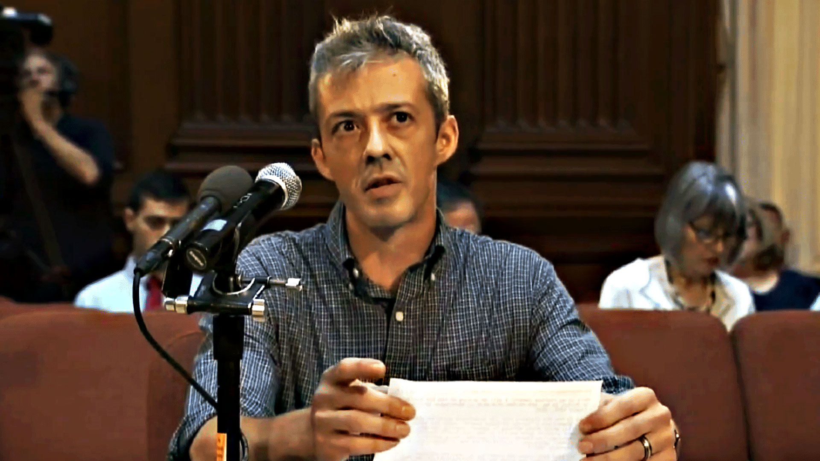
“Why is the EPA claiming that six greenhouse gases emitted from jet planes are a “threat to human health” under the Clean Air Act while doing nothing to address ongoing lawsuits over leaded aviation gasoline or the real health concerns of stakeholders worldwide: cancer-causing, heavy metals in fuels and their additives, and aviation-induced cloudiness (AIC)?”
https://climateviewer.com/2015/08/09/my-speech-to-the-epa-about-flight-pollution/

Slide 43
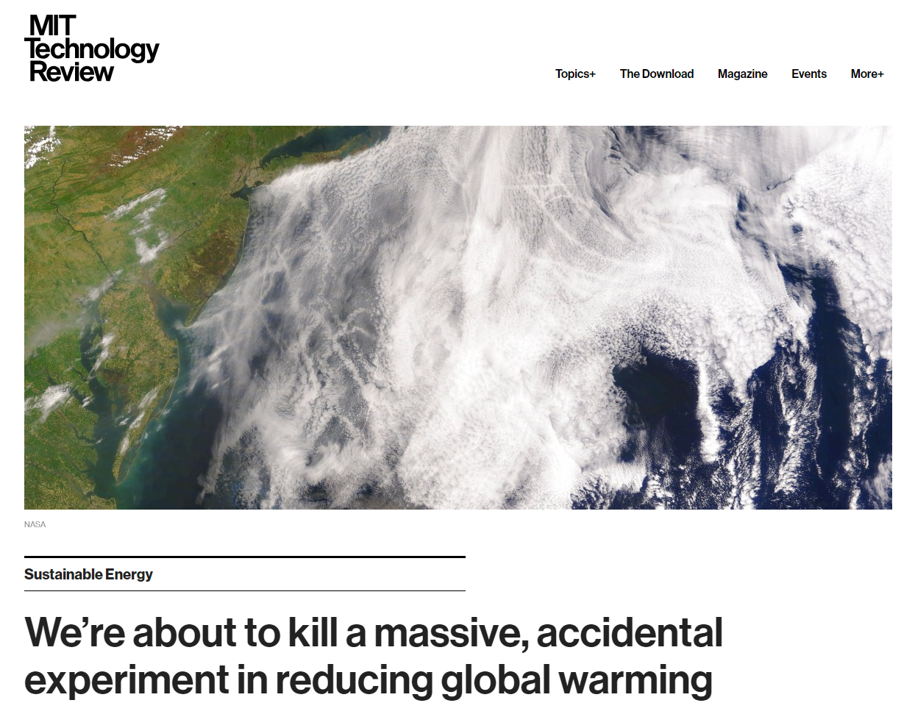
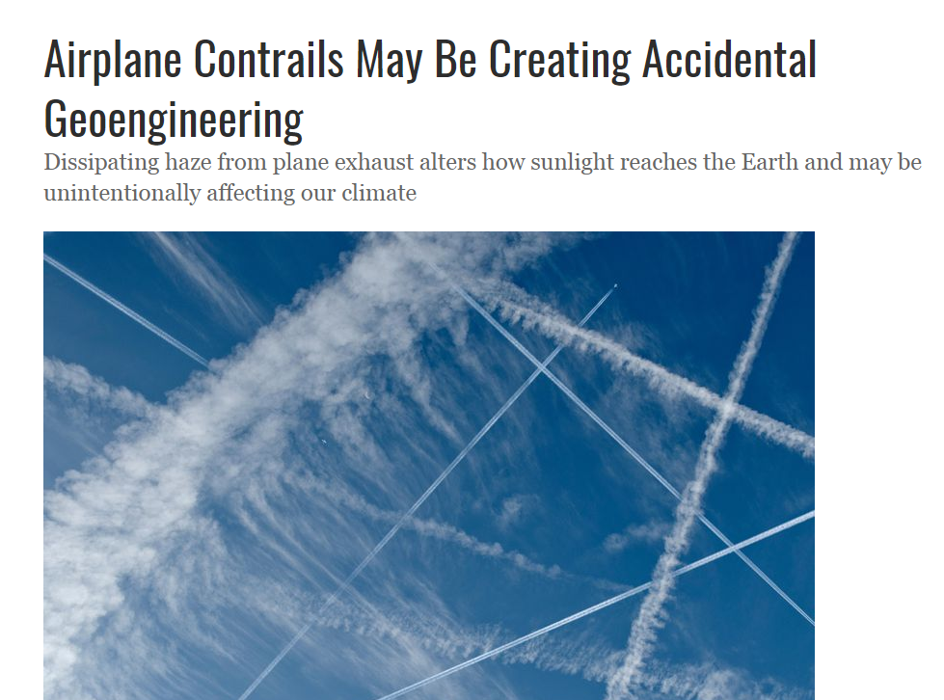
ARTIFICIAL CLOUDS
Technocrats have decided to replace natural cloud formation with technological fixes dubbed “Accidental Geoengineering”: Ship Tracks and Aircraft Contrail-Induced Cirrus Clouds.
https://climateviewer.com/2018/04/01/accidental-geoengineering-with-ship-tracks-contrails/

Slide 44
GEOENGINEERING

Slide 46
DOPED JET FUEL GEOENGINEERING
“The particles may be seeded by dispersal from seeding aircraft; one exemplary technique may be via the jet fuel as suggested by prior work regarding the metallic particles. Once the tiny particles have been dispersed into the atmosphere, the particles may remain in suspension for up to one year.” Chang, David B., and I-Fu Shih. “Stratospheric welsbach seeding for reduction of global warming.” U.S. Patent No. 5,003,186. 26 Mar. 1991.
“Use commuter aircraft fuels doped with aerosol generators” The only approach that might be feasible is to perform wide-area seeding with soot or carbonaceous aerosols (Carbon Black Dust) which would absorb solar radiation and warm cirrus layers enough to perhaps dissipate cirrus clouds (a semi-direct effect). This strategy would be similar to that proposed by Watts (1997) and Crutzen (2006) for implementation in the stratosphere. As noted by Crutzen (2006) only 1.7% of the mass of sulfur is needed to produce a similar magnitude of surface cooling. Cotton, WR. “Weather and Climate Engineering.” · 17th Conference on Planned and Inadvertent Weather Modification. (2008) VIDEO
A potential delivery mechanism for the seeding material is already in place: the airline industry. Since seeding aerosol residence times in the troposphere are relatively short, the climate might return to its normal state within months after stopping the geoengineering experiment. The main known drawback to this approach is that it would not stop ocean acidification. It does not have many of the drawbacks that stratospheric injection of sulfur species has. “dissolved or suspended in their jet fuel and later burned with the fuel to create seeding aerosol, or injected into the hot engine exhaust, which should vaporize the seeding material, allowing it to condense as aerosol in the jet contrail” Mitchell, David L., and William Finnegan. “Modification of cirrus clouds to reduce global warming.” Environmental Research Letters 4.4 (2009): 045102.
“Options for dispersing gases from planes include the addition of sulfur to the fuel, which would release the aerosol through the exhaust system of the plane, or the attachment of a nozzle to release the sulfur from its own tank within the plane, which would be the better option.” Robock, Alan, et al. “Benefits, risks, and costs of stratospheric geoengineering.” Geophysical Research Letters 36.19 (2009).
Here we describe an alternate method in which aerosol is formed rapidly in the plume following injection of H2SO4 (sulfuric acid), a condensable vapor, from an aircraft. Pierce, Jeffrey R., et al. “Efficient formation of stratospheric aerosol for climate engineering by emission of condensible vapor from aircraft.”Geophysical Research Letters 37.18 (2010).
“Another technique examined was the use of commercial passenger aircraft flying at high altitudes to inject sulphate aerosols, emitted by aviation fuel, into the stratosphere.” Partanen, Antti-Ilari, et al. “Studying geoengineering with a climate model, COOL Project.” · Academy of Finland, Article (2014)
“Applying high FSCs (Fuel Sulfur Content) at aviation cruise altitudes combined with ULSJ fuel (Ultra-low Sulfur Jet, Biofuel) at lower altitudes results in reduced aviation-induced mortality and increased negative RE compared to the baseline aviation scenario” Kapadia, Z. Z., Spracklen, D. V., Arnold, S. R., Borman, D. J., Mann, G. W., Pringle, K. J., Monks, S. A., Reddington, C. L., Benduhn, F., Rap, A., Scott, C. E., Butt, E. W., and Yoshioka, M.: Impacts of aviation fuel sulfur content on climate and human health, Atmos. Chem. Phys. Discuss., 15, 18921-18961, doi:10.5194/acpd-15-18921-2015, (2015).

Slide 47
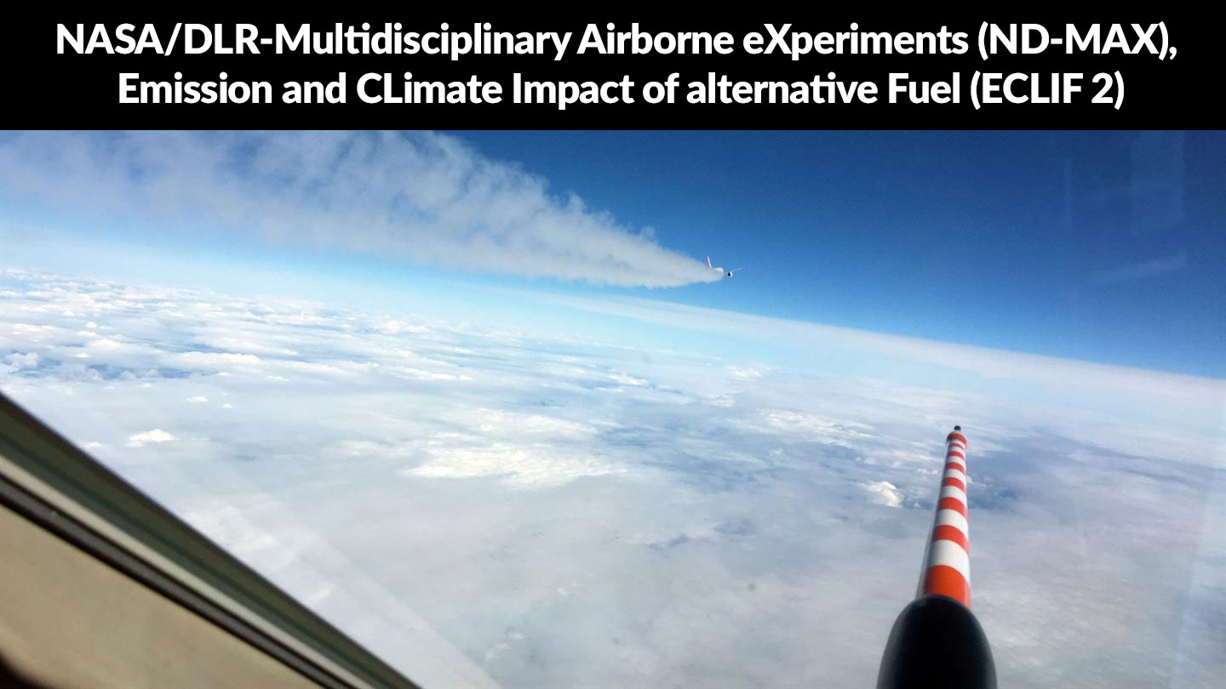
DOPED JET FUEL GEOENGINEERING
BIOFUELS FOR CONTRAIL CONTROL – 2013-Present
Three different fuel types are discussed: a low-sulfur JP-8 fuel, a 50:50 blend of JP-8 and a camelina-based HEFA fuel (BIOFUEL), and the JP-8 fuel doped with sulfur. Moore, Richard H. et al. “In-Situ Measurements of Contrail Properties Measured During the 2013-2014 ACCESS Project.” 14th Conference on Cloud Physics. (2014)
https://weathermodificationhistory.com/jet-biofuel-enlisted-for-contrail-control/
https://weathermodificationhistory.com/multidisciplinary-airborne-experiments-emission-climate-impact-alternative-jet-fuel-nd-max-eclif-2/

Slide 49
DOPED JET FUEL GEOENGINEERING
COMPUTER MODELS DETERMINE WHEN AND WHERE TO INJECT SULFUR

Slide 51
CIRRUS CLOUD THINNING
Seeding cirrus clouds to destroy them or thin them out at night - VIDEO
“sedimenting ice crystals remove water vapor, the most important natural greenhouse gas, from the upper troposphere. If cirrus thinning works, it should be preferred over methods that target changes in solar radiation, such as stratospheric aerosol injections, because cirrus thinning would counteract greenhouse gas warming more directly.”

Slide 52
SOLUTIONS

Slide 53
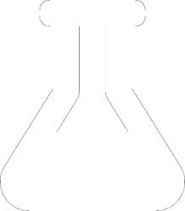
CARBON BLACK DUST & SOOT
HOW TO DEAL WITH THE PROBLEM OF SECRET WEATHER MODIFICATION
https://climateviewer.com/enmod/
COMMERCIAL
SCIENTIFIC
MILITARY
DON’T FLY
Tell the airline industry “You’re #GROUNDED!”
Demand the ICAO, FAA, NASA, and the DLR pursue options to stop creating cirrus clouds.
Support The Environmental Modification Accountability Act.
Demand Transparency: a worldwide requirement to give prior notification before experimenting in the sky.
Build a sensor network to detect illegal weather modification & geoengineering activity.
Support The Environmental Modification Accountability Act.
Give the Weather Warfare ban of 1978 teeth.
Build a sensor network to detect illegal weather warfare activity.
Pursue a complete ban on Space Weather Modification (Ionospheric Heaters, Rockets)

Slide 54
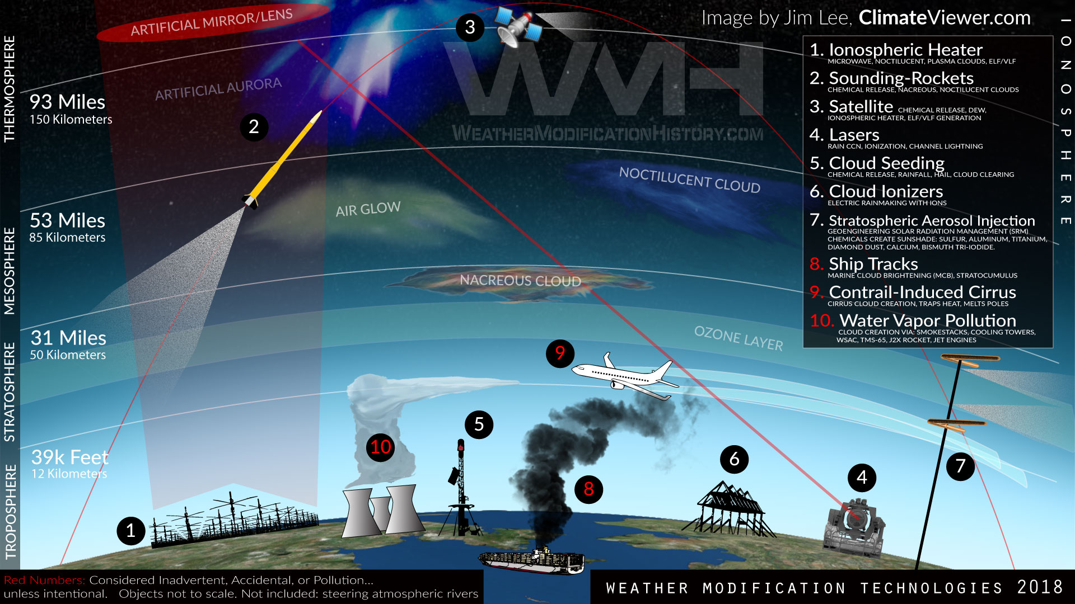

Slide 56
THANK YOU
“Never doubt that a small group of thoughtful, committed citizens can change the world; indeed, it's the only thing that ever has.” - Margaret Mead

Slide 57
James Franklin Lee Jr.
ClimateViewer News, LLC
1637 North Main St.
Sumter, South Carolina 29153
+1 (803) 450-4305 jim@climateviewer.com Skype: rezn8d climateviewer.com
climateviewer.org
weathermodificationhistory.com
Support My Work
Patreon
Paypal
GoFundMe
THIS PRESENTATION MAY BE FREELY DOWNLOADED AND DISTRIBUTED FROM: CLIMATEVIEWER.COM/CIRRUSCLOUDSMATTER
CARBON BLACK DUST & SOOT : The Chemtrail Secret for Weather Warfare, Geoengineering, and Ozone Destruction

